Slide 1

Oh
CANADA
Canadian Graduation, Employment,
Debt
and Earnings
Madeline Packard Arthur DeVitalis

Slide 2
Questions
?
?
?

Slide 3
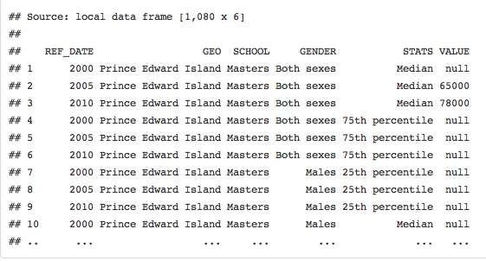
Grad Earnings, by Gender and Median Earning dataframe

Slide 4
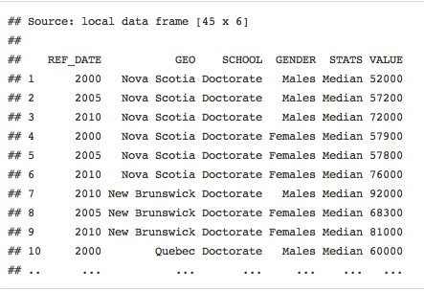
Average Doctorate earnings dataset

Slide 5
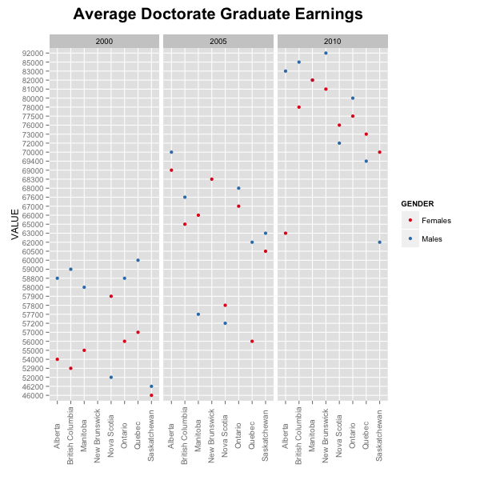

Slide 6

Average college graduate earnings dataset

Slide 7
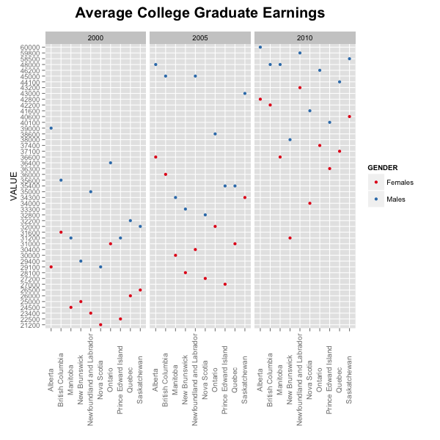

Slide 8
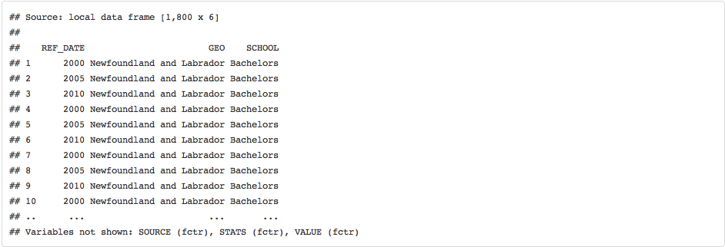
Grad Debt, by Averages and Percentages of Grads who have Paid Off dataframe

Slide 9
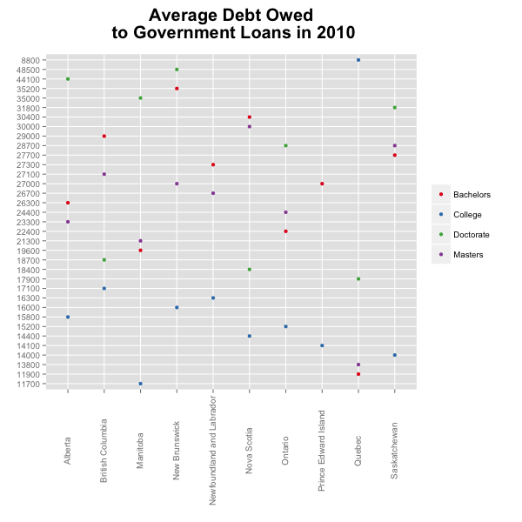

Slide 10
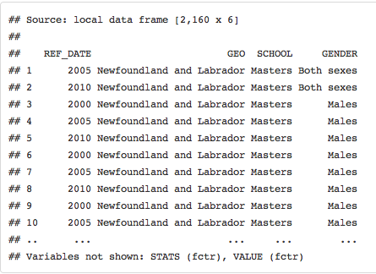
Grad Employment, by Rates and Percentages dataset

Slide 11
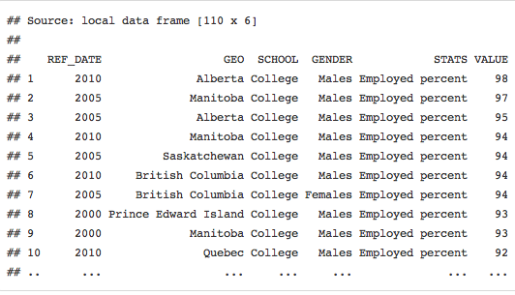
Grad Employment, by Rates and Percentages dataframe

Slide 12
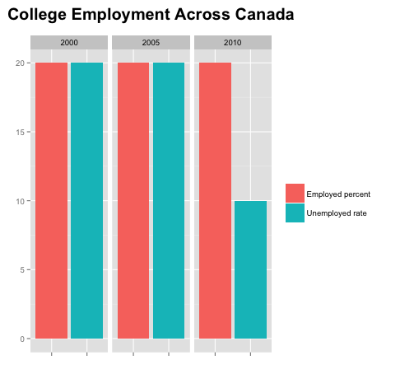

Slide 13
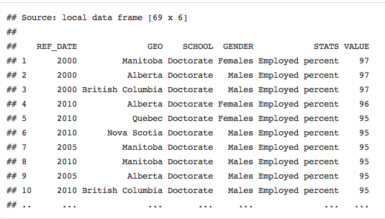
Average Doctorate Employment Rates

Slide 14
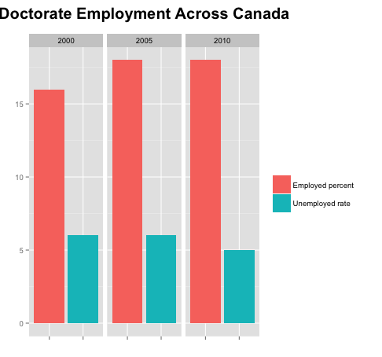

Slide 15
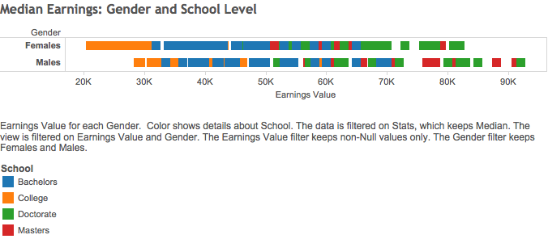

Slide 16
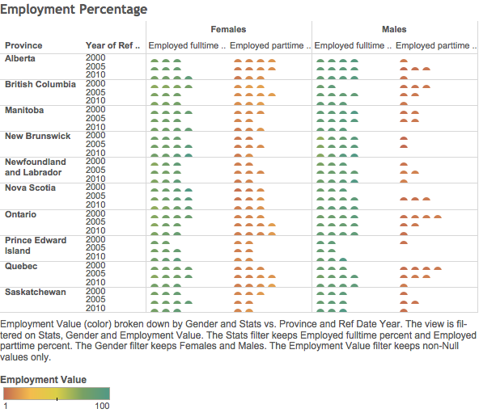

Slide 17
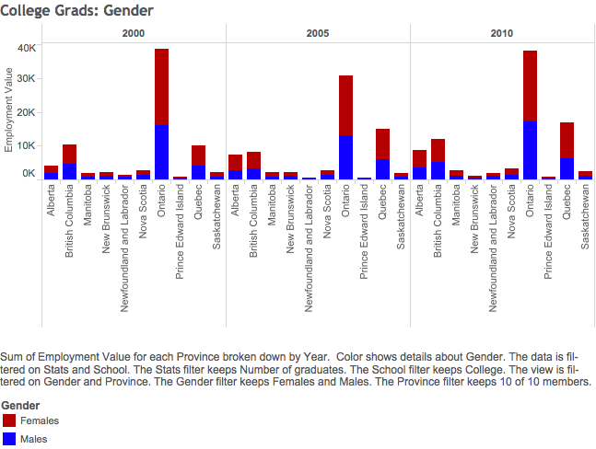

Slide 18
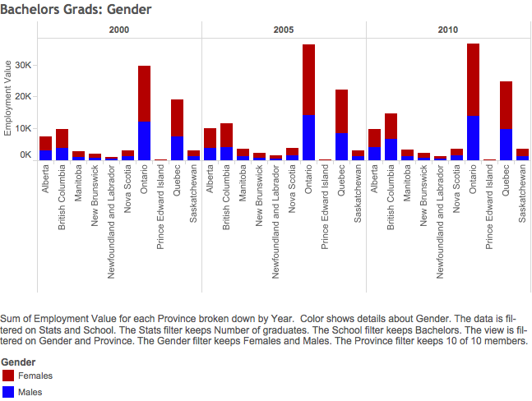

Slide 19
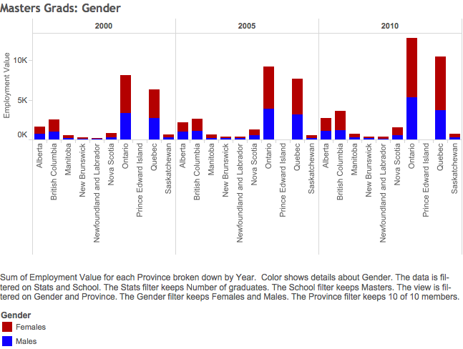

Slide 20
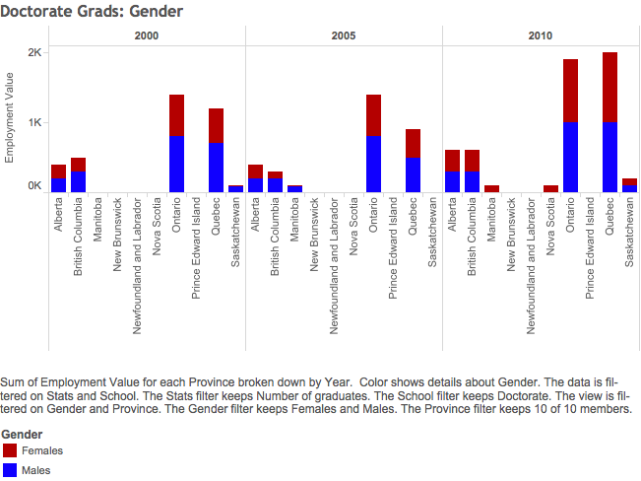

Slide 21
